Slide 1

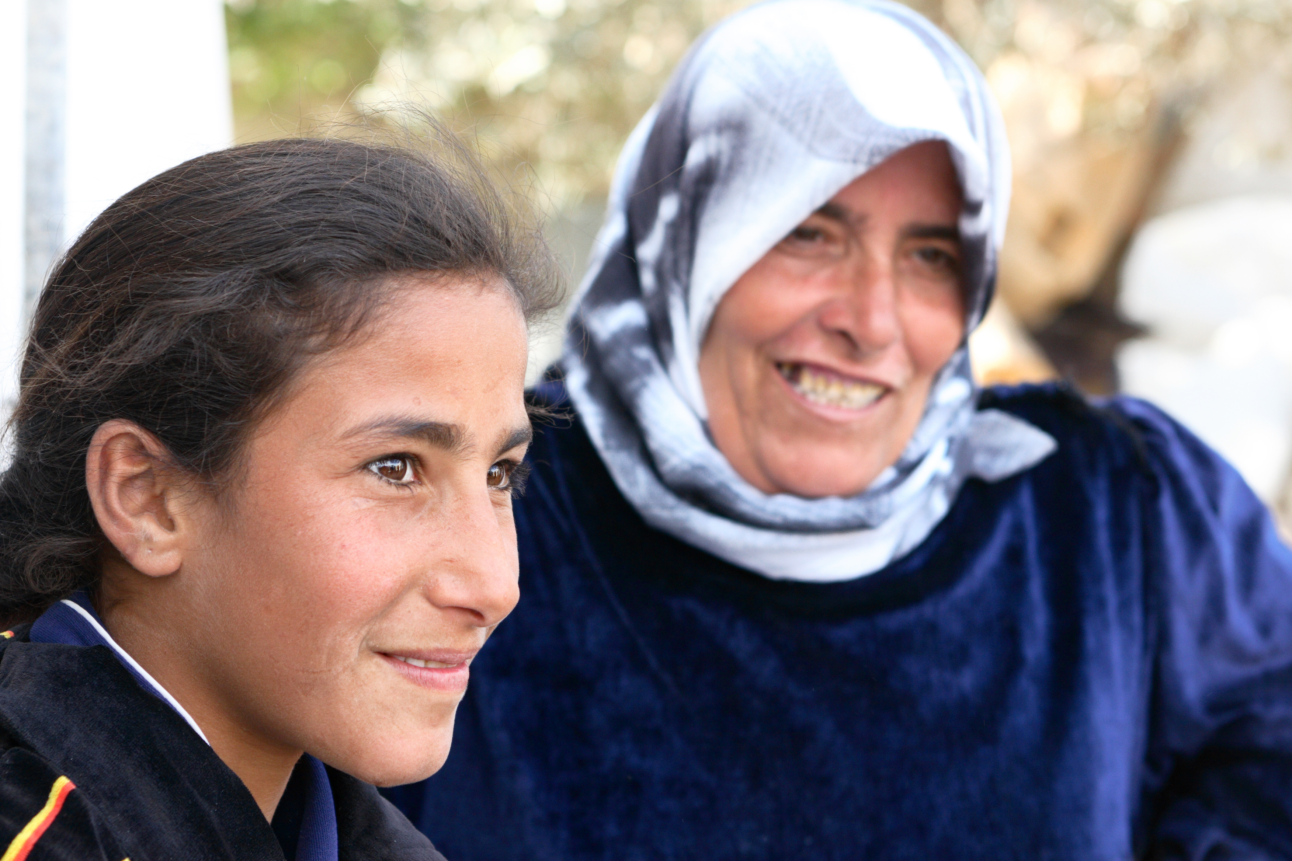
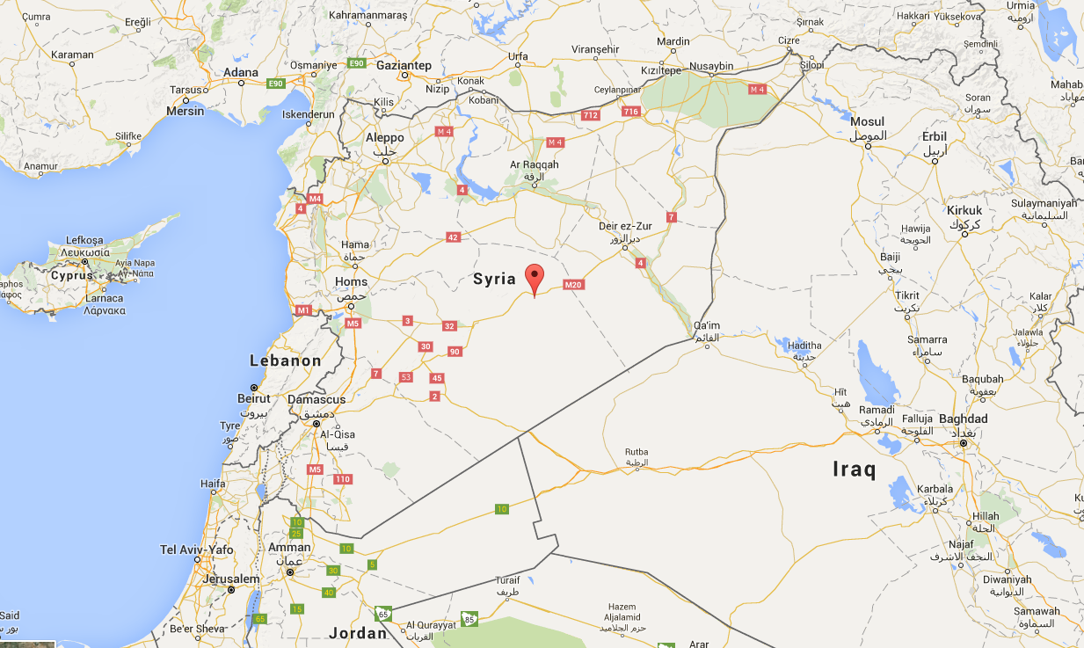



NOTES ON USING THE TEMPLATE
Please update with your own content images, graphics and copy
Use the IPPF AssetBank http://ippf.assetbank-server.com/ to find photography, pictograms and infographics
Replace images by right clicking and selecting change image (this could vary between versions so you may need to search online for help)
Format your images to make them fit correctly in the boxes, scale them out, crop them, you should be able to access the format menu by right clicking on the image
Make use of PowerPoint SmartArt to display your data and process
Use Arial and Arial Narrow as your fonts
Don’t overcrowd the flyer, make your points quickly and do not overload the design, keep it simple, clean and to the point
For a completely clean version of this template you can delete this example and then add new slides applying the master pages.
ADD your content here?
Example: the next step in the process was too…
3
Example: the next step in the process was too…
Make use of smart art to display your processes and data
1
2
The results of these steps
Maybe add some to contraception
Peer to Peer education etc…

Slide 2
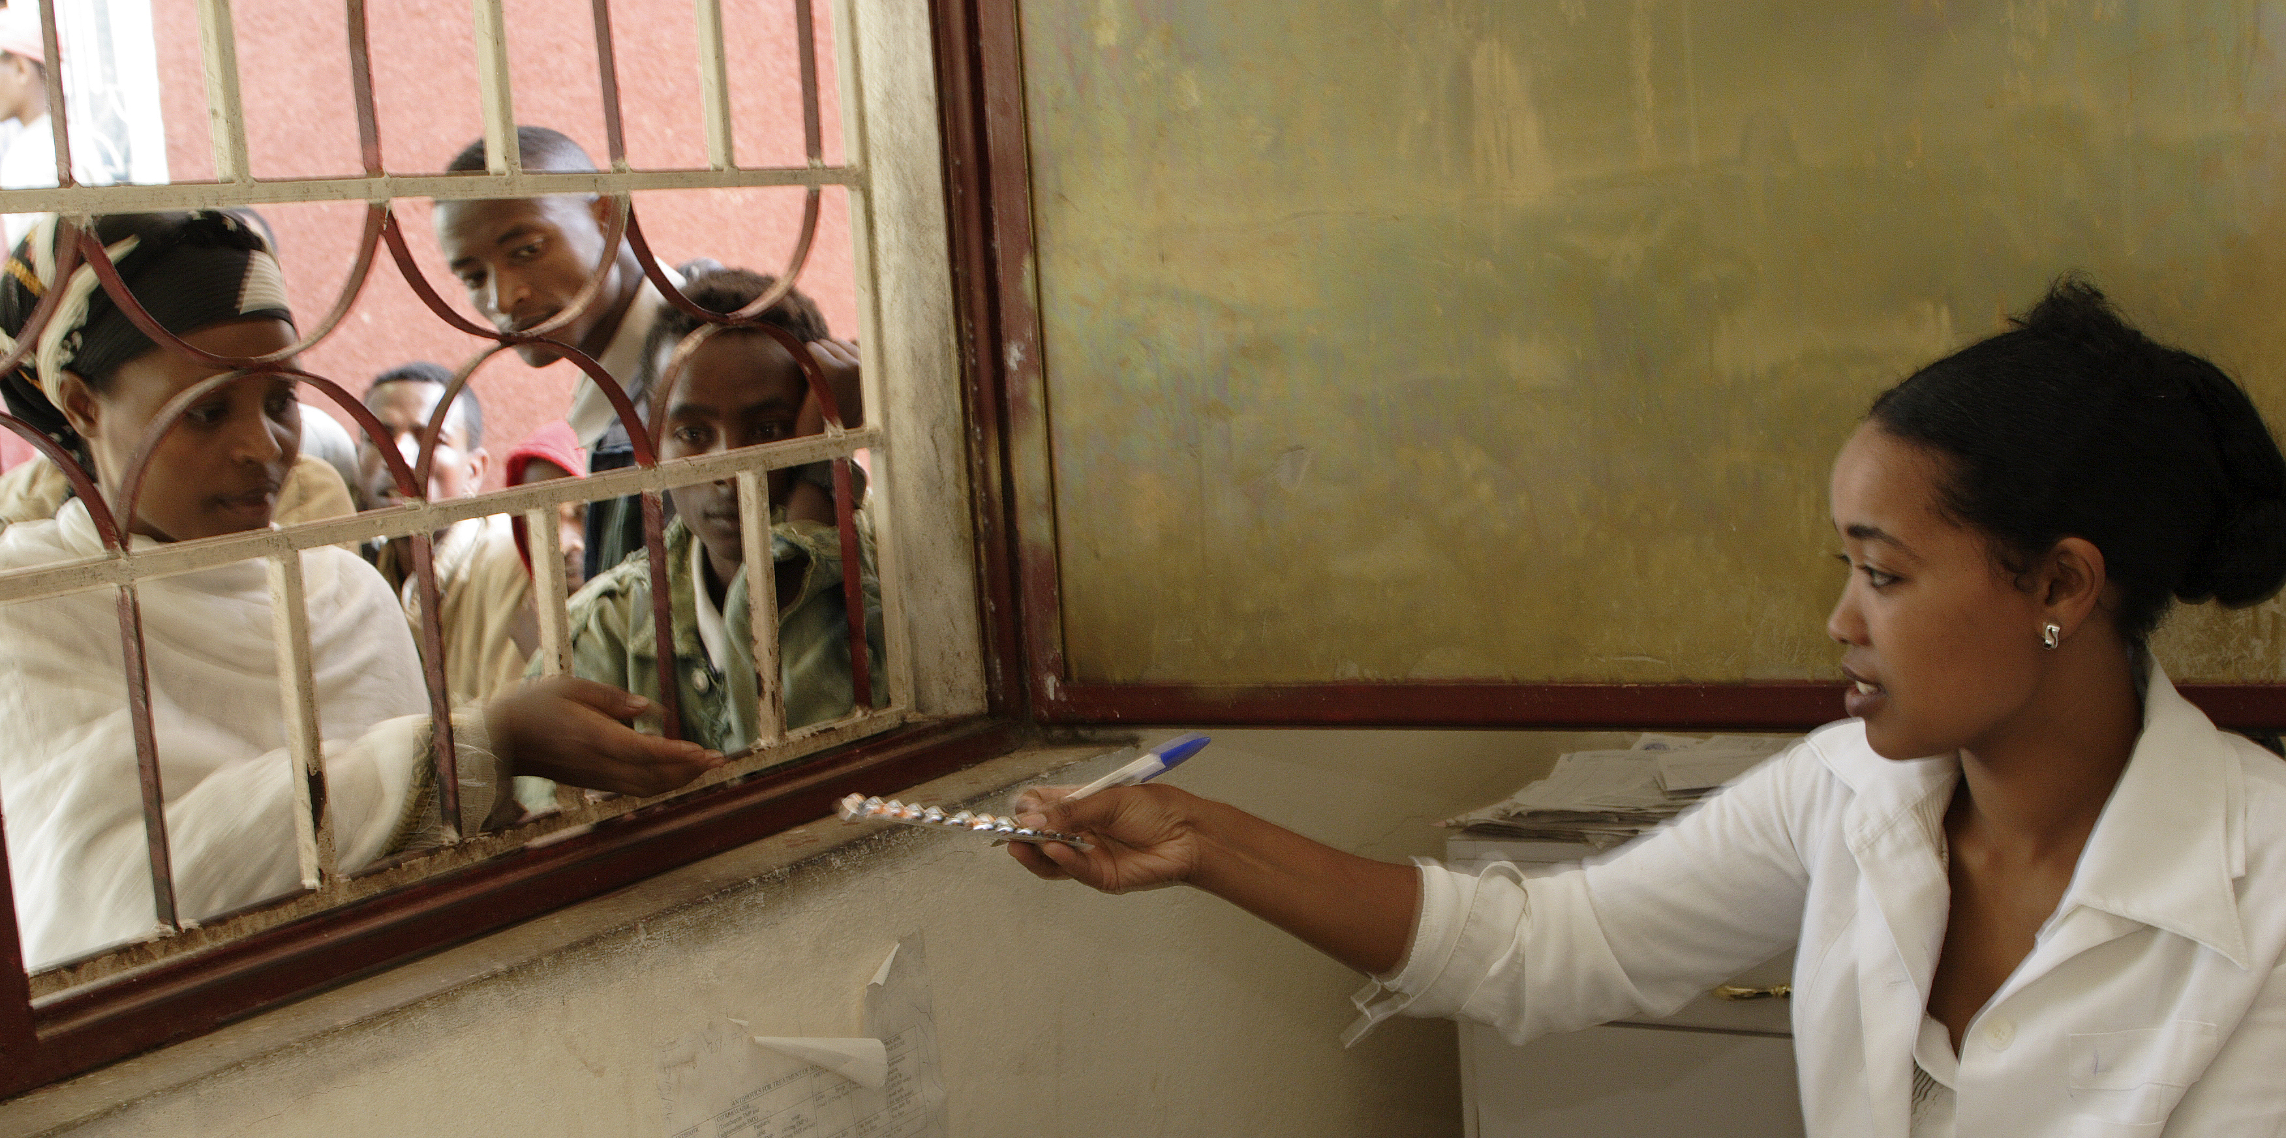
89% decrease in unwanted pregnancy and greater family planing
Peer to Peer training
CSE programme implemented
Contraceptive Services provided
add some text here

